Slide 1
Data Structures, Algorithms, and ADT’s
CS240 Spring 19

Slide 2
What are Data Structures?
What is an unsigned integer value of 1 on a 32 bit computer?
What can you do with a 1?
A data structure is any data representation and its associated operations.

Slide 3
Why do Data Structures matter?
We must figure out a way to organize data in a way that is manageable
The most obvious example is an unsorted array.

Slide 4
What problem do Data Structures solve?
Assume you have an unsorted array with an unstable data set
For example, you have an array of 10,000 movies on netflix, and the current number of people watching each of these movies.
The Movie ID corresponds to an array index which holds the number of people watching that movie.
int net_movies_watchers[10000] = {0};

Slide 5
What problem do Data Structures solve?
You are writing an application that displays the top 5 watched movies on netflix at any given moment
The application allows the user to check how many people are watching any given movie.
What operations are important? i.e. What needs to be fast, and what doesn’t have to be?
Using the proper data structure can make the difference between a program running quickly or not at all.

Slide 6
Resource constraints
Data Structures require what two resources?
All data structures and algorithms are measured according to their use of these two resources
The effectiveness of a Data Structure or Algorithm is considered its ‘Cost’

Slide 7
Selecting a data Structure
When selecting a data structure to solve a problem:
Determine the basic operations that are required.
Determining the best ADT for a problem always depends on resource constraints.
Select the data structure that best meets these requirements.

Slide 8
Additional Constraints
When is data inserted?
Stable data
Unstable data
How is data accessed?
Are all data items processed in the same order every time?
"Random access" search generally requires more complex data structures.

Slide 9
Abstract Data Types
So a Data Structure is just a concrete collection of data and operations.
A data structure is an implementation of an Abstract Data Type
ADTs are language independent

Slide 10
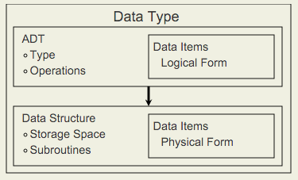
How is an ADT different from a Data Structure?
Important: An ADT does not specify how the data type is implemented.
An ADTs interface is defined in terms of:
a type name
a set of operations on that type

Slide 11
ADT vs Data Structure
Suppose a particular programming environment provides a library that includes a list class.
A variety of implementations for lists is possible. The particulars of the implementation is the Data Structure.

Slide 12
Course Topics
In this course we will do 3 things:
Add a collection of data structures and algorithms to our toolkit.
Explore the idea of tradeoffs
Learn how to measure the effectiveness of a data structure or algorithm.
With each ADT we will explore an algorithm along with that ADT
The algorithm will sometimes require that particular ADT, but not always

Slide 13
How to choose?
Primarily, we will strive for two goals:
Design data structures and algorithms that are
easy to understand
easy to code
easy to debug
Design data structures and algorithms that makes efficient use of the computer's resources.
Simplicity vs Simplistic

Slide 14
Classwork
ADT

